Slide 1
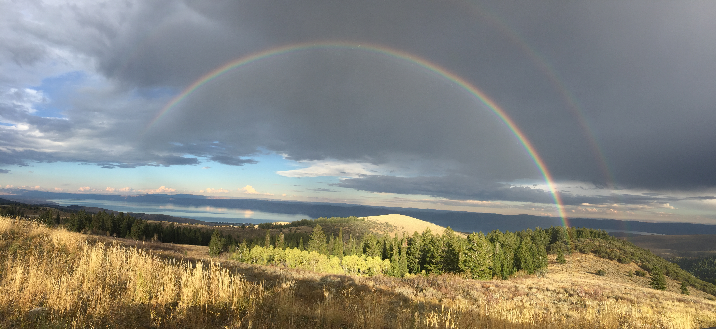

HydroShare for iUTAH: Collaborative Publication, Interoperability, and Reuse of Hydrologic Data and Models for a Large, Interdisciplinary Water Research Project
Jeffery S. Horsburgh
Amber Spackman Jones
iUTAH CI and HydroShare Teams

Slide 2

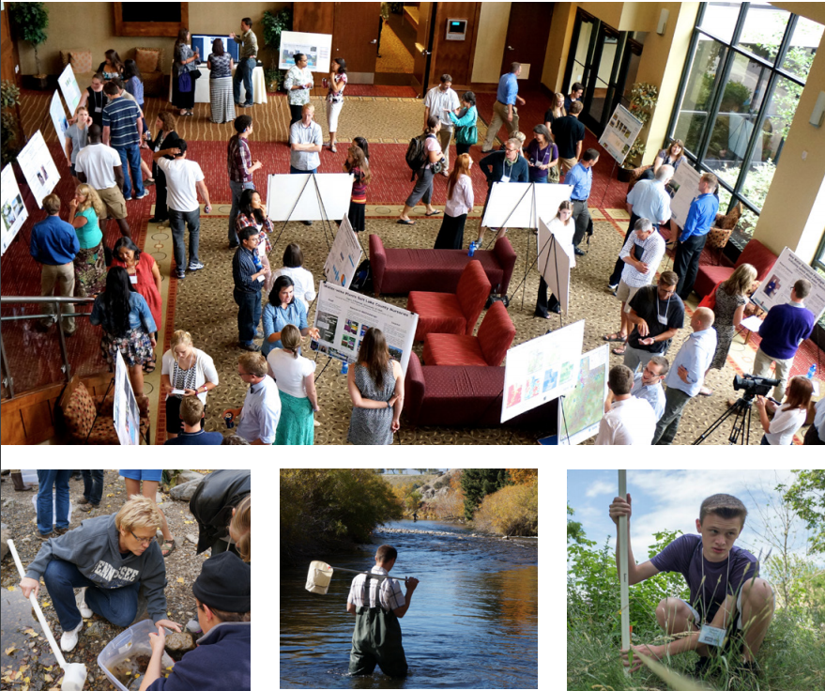
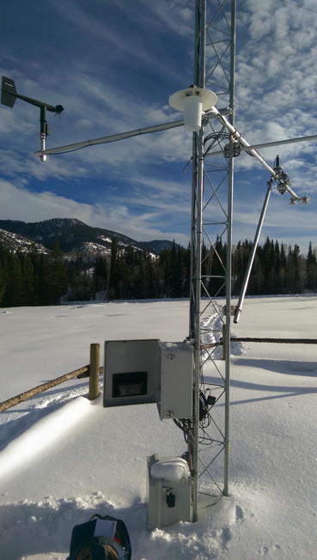
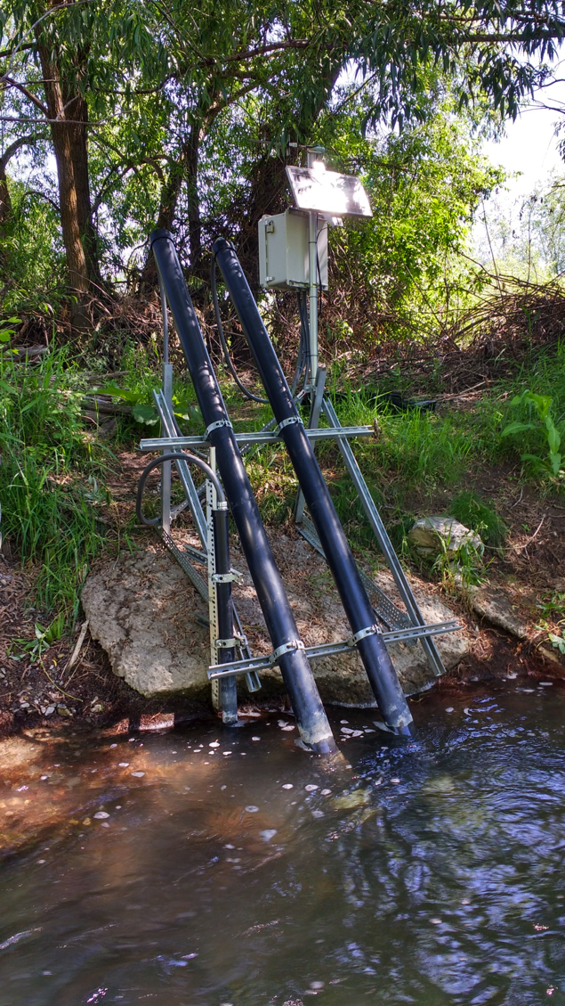
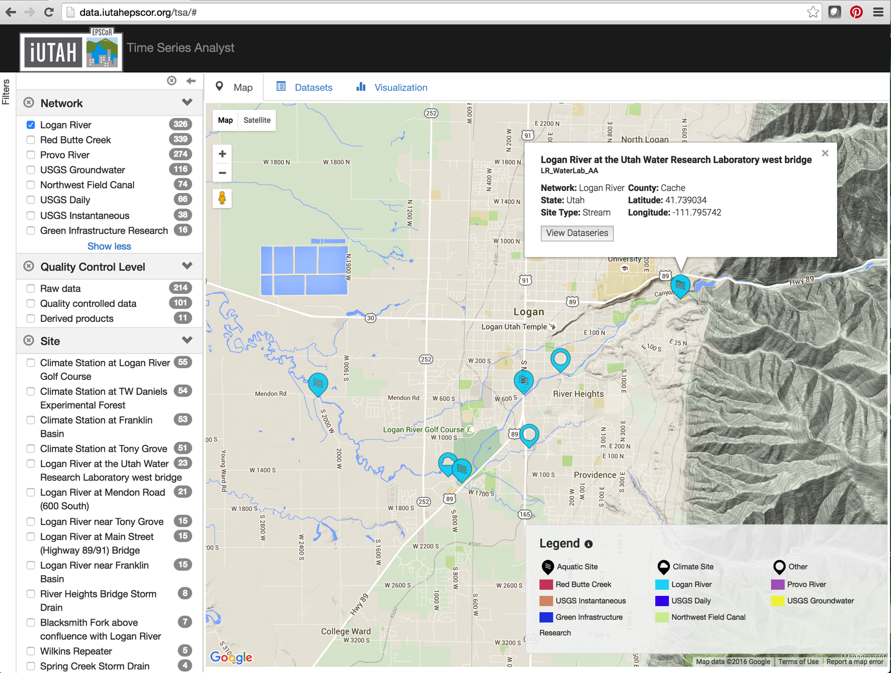
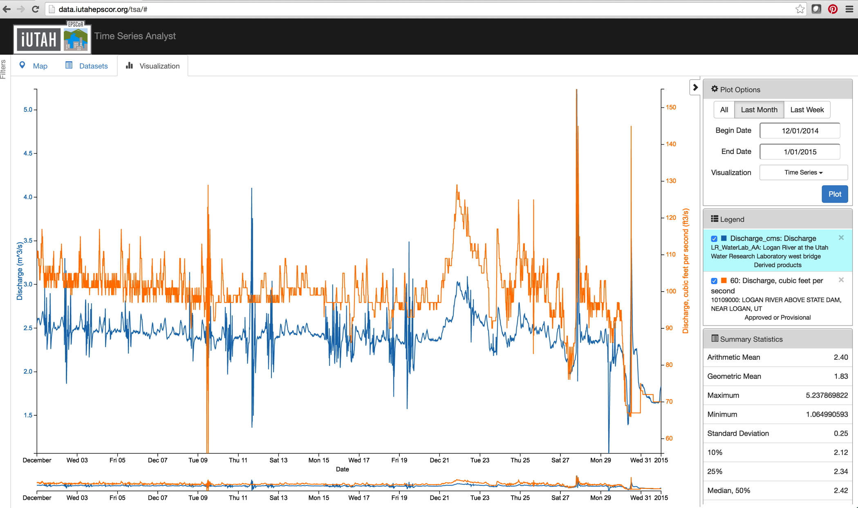
iUTAH: innovative Urban Transitions and Aridregion HydroSustainability
Multi-institution, interdisciplinary project
Focused on water sustainability in Utah
Seeks to integrate and share social and biophysical water data
Research capacity building
Human infrastructure
Observational infrastructure
Cyberinfrastructure
Notes:
aims to capture and integrate information about the human and natural aspects of water resources within the state of Utah
iUTAH has faced and addressed data sharing and publication challenges across biophysical and social sciences.

Slide 3
- iUTAH Proposal Data Management Plan
“All of the primary datasets collected as part of this project will be made freely and publicly available…”

Slide 4
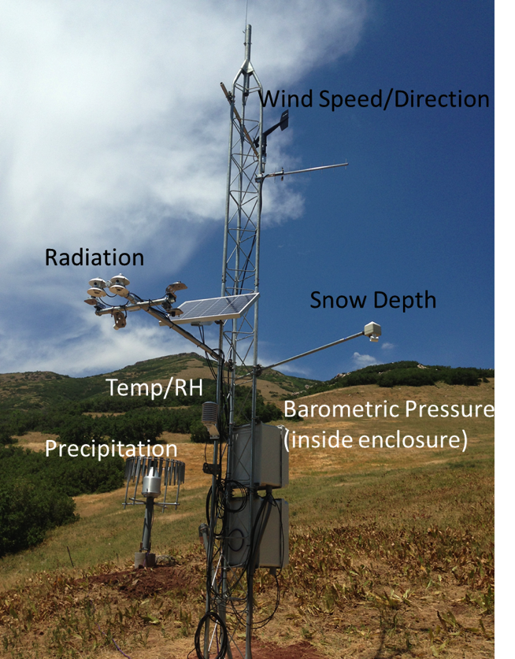
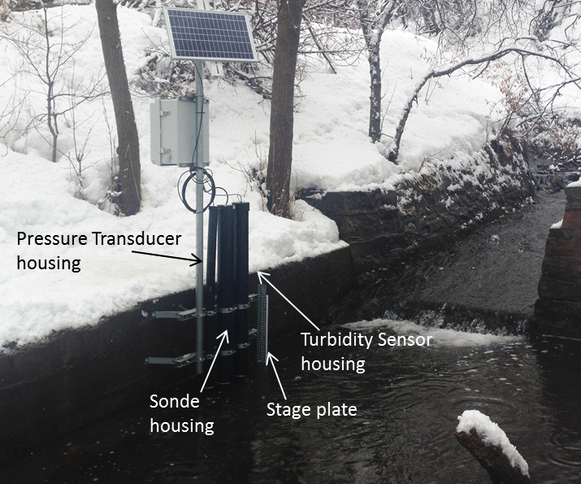
iUTAH Sensor Data Workflow
Jones, A.S., J. S. Horsburgh, S.L. Reeder, M. Ramirez, J. Caraballo (2015). A data management and publication workflow for a large-scale, heterogeneous sensor network, Environmental Monitoring and Assessment, 187:348, http://dx.doi.org/10.1007/s10661-015-4594-3.

Slide 5







iUTAH Investigator Data Workflow
Easily create a digital instance of a dataset or model
Quickly share it with colleagues (perhaps privately at first)
Add value through collaboration, annotation, and iteration
Describe with metadata
Eventually…share publicly or formally Publish
DOI
META
iUTAH investigator datasets/products are diverse…
Notes:
Focusing in on one generalized workflow for doing science:
the tools we have available to use to do this can still be difficult to string together, and it isn’t clear how to get from point A to point B
There’s collaboration that happens along the way, and the tools that we have available to us now don’t foster that collaboration

Slide 6
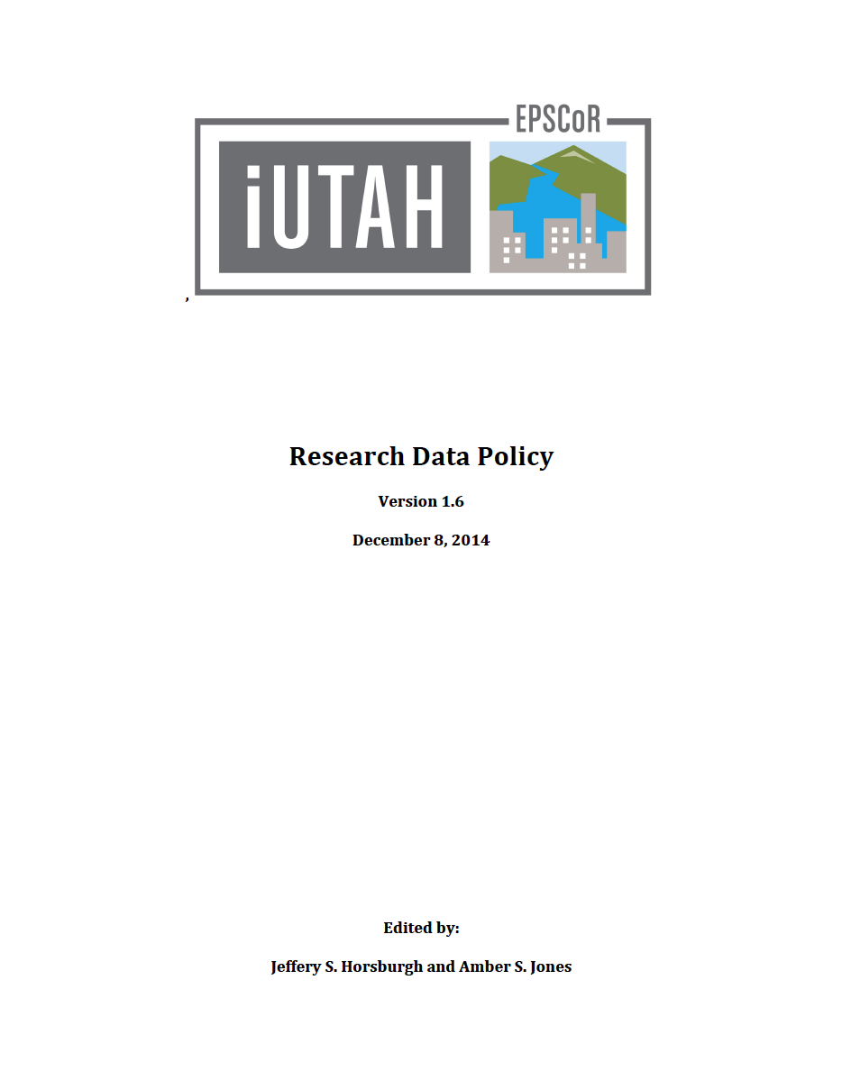
iUTAH Data Policy
Formal data policy for the iUTAH project
Roles and responsibilities
Data collection plans
Data and metadata standards
Data typology
Timing for submission and publication
Focused on meeting obligations of our data management plan
Changing culture from “My data” to “Our data”

Slide 7
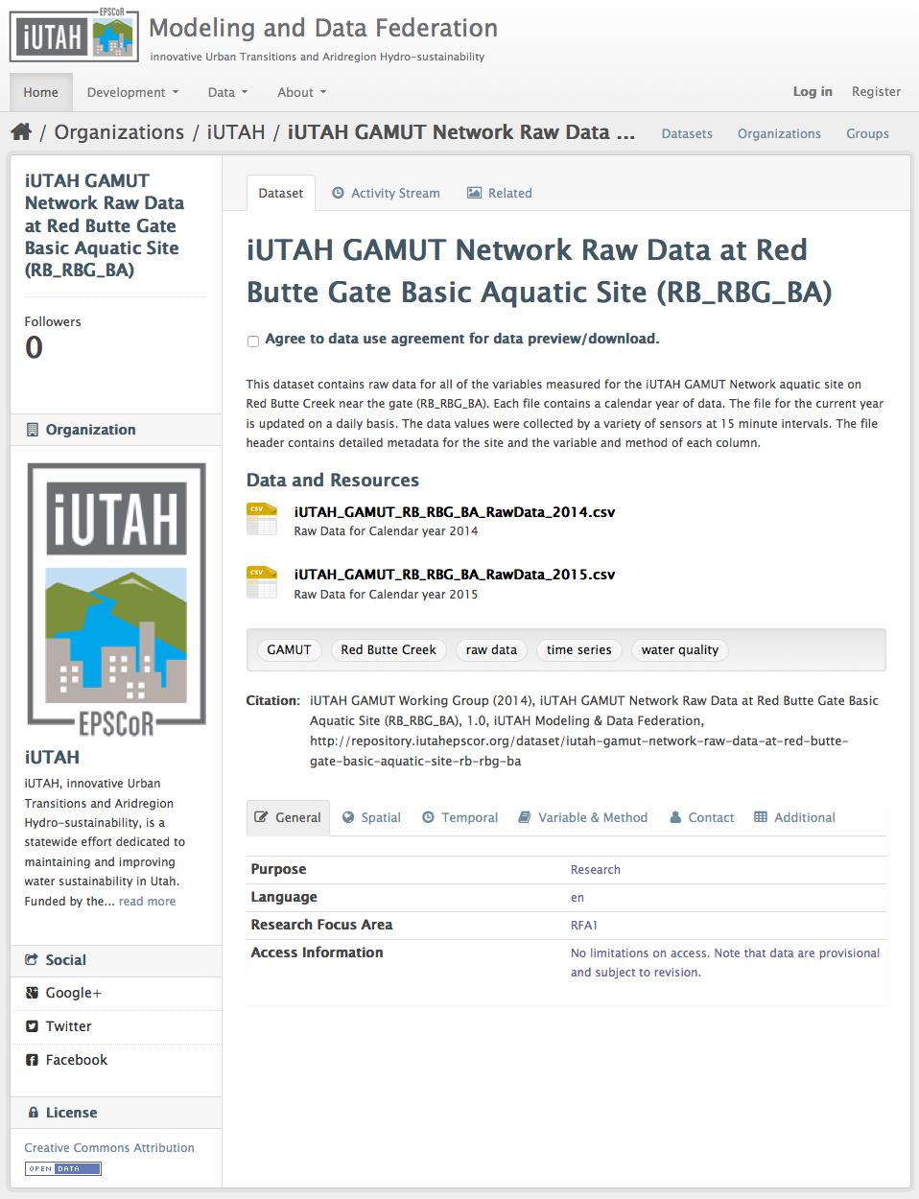
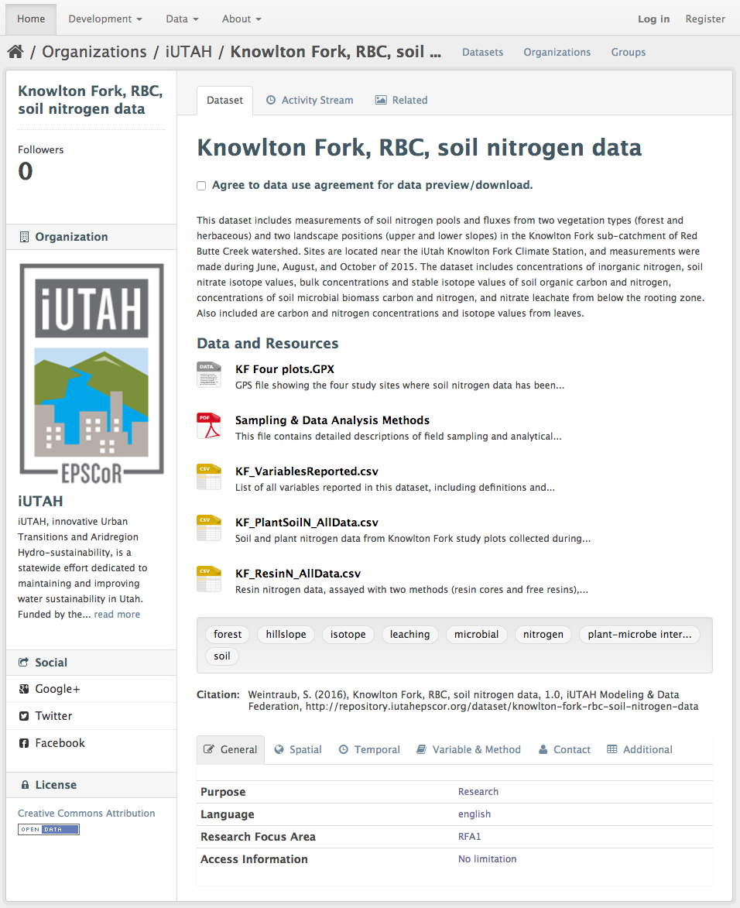
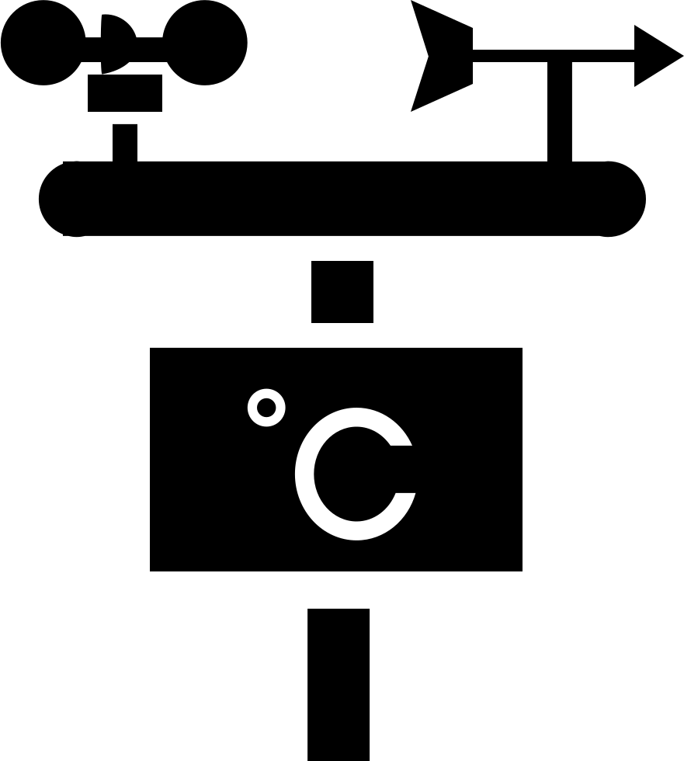
Original iUTAH Data Repository
Single repository for all iUTAH datasets
Dataset upload and publication
Dataset landing page
Permanent URL and citation
Limited curation process
Limitations
Not flexible (enough)
Hard to maintain
No real collaboration capabilities
No DOI for published resources
Utah “graduated” from the EPSCoR program → sustainability became an issue
Individual Investigator
Datasets
Automated Publication of
Sensor Datasets

Slide 8
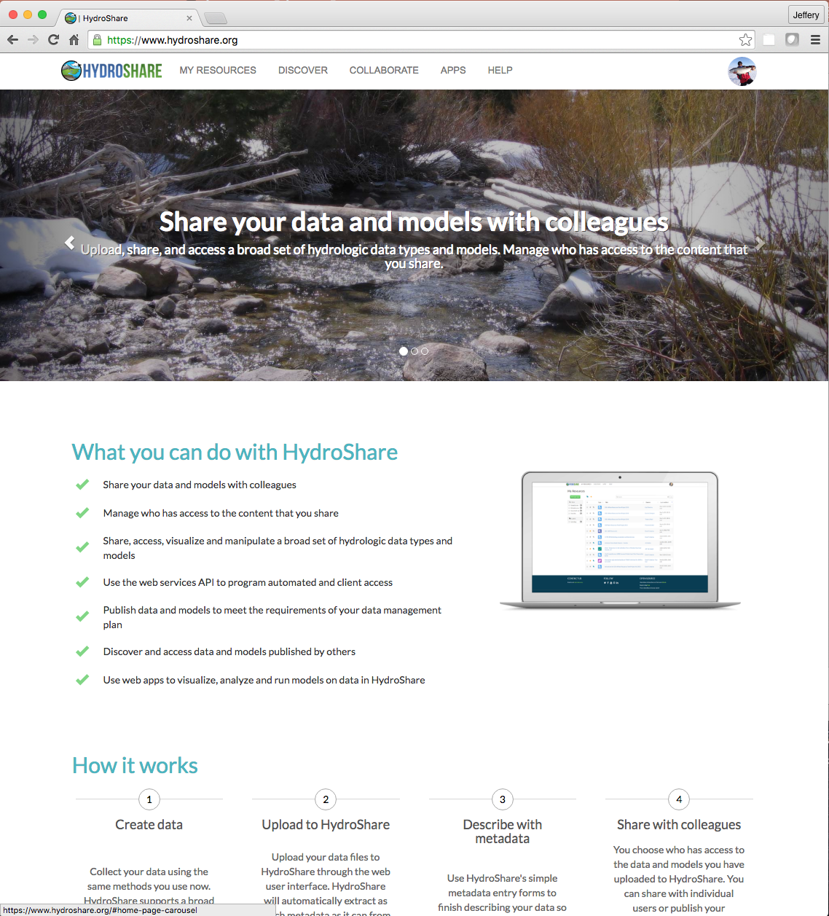

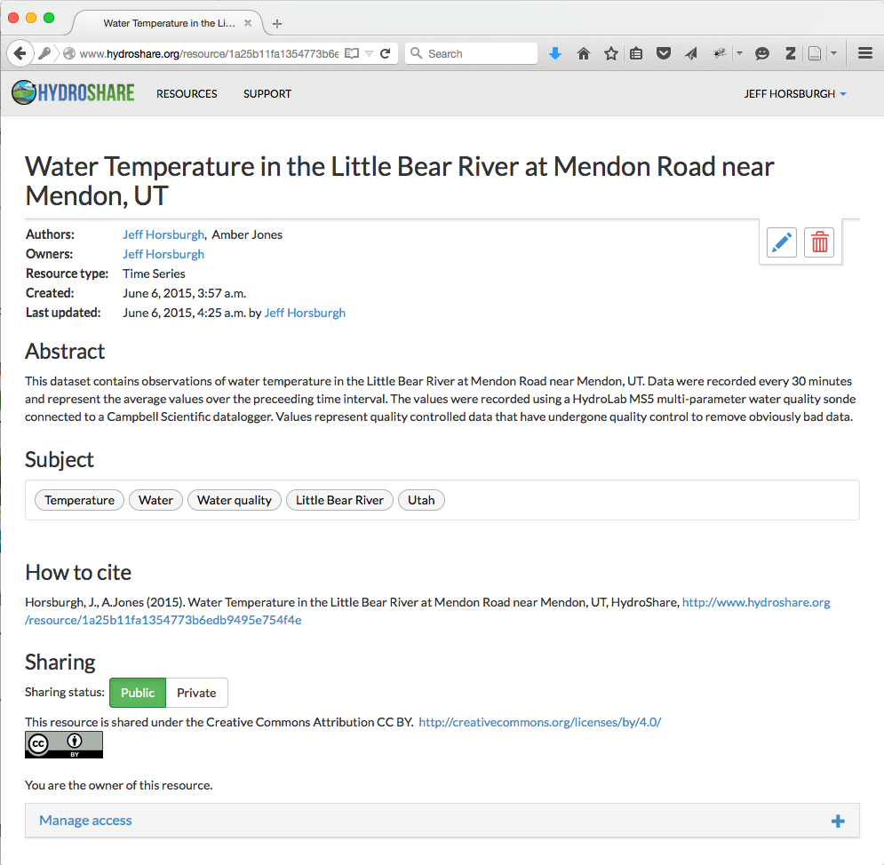
http://www.hydroshare.org
Collaborative development project that started about the same time as iUTAH
Sharing and collaborating around diverse data types used by water scientists
Could HydroShare meet some or all of the data management and sharing needs for the iUTAH project?

Slide 9
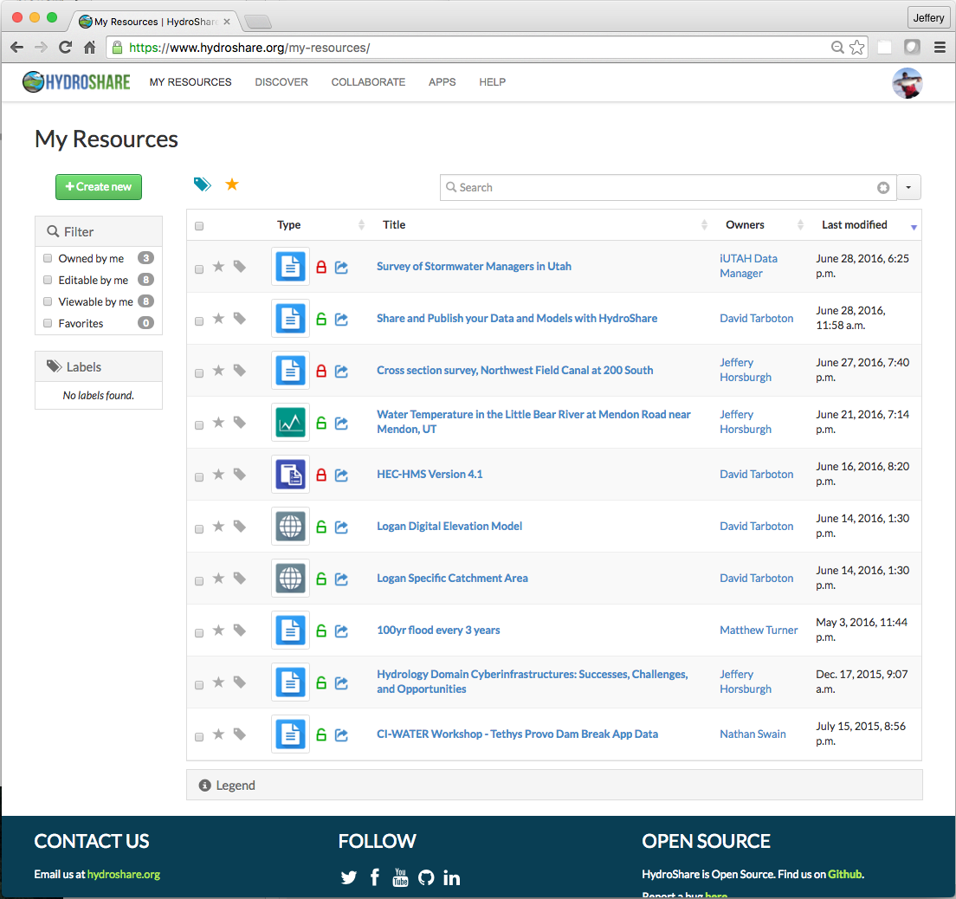
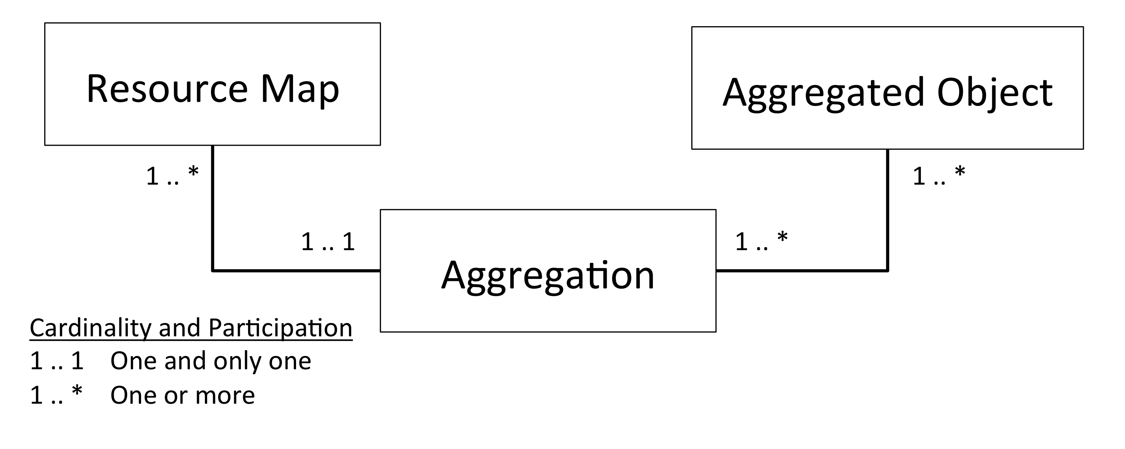
HydroShare “Resources”
Resources can be datasets, models, or other digital content
Resource = primary unit of digital content
Create
Share
Own
Access
Filter
Discover
Publish
All the stuff we wanted to do with iUTAH datasets!
A file that is part of a Resource
An XML document that encodes the description of a Resource and the Aggregation
A list of all of the objects/files
aggregated within the resource
An profile of the Open Archives Initiative’s Object Reuse and Exchange (OAI-ORE) standard

Slide 10
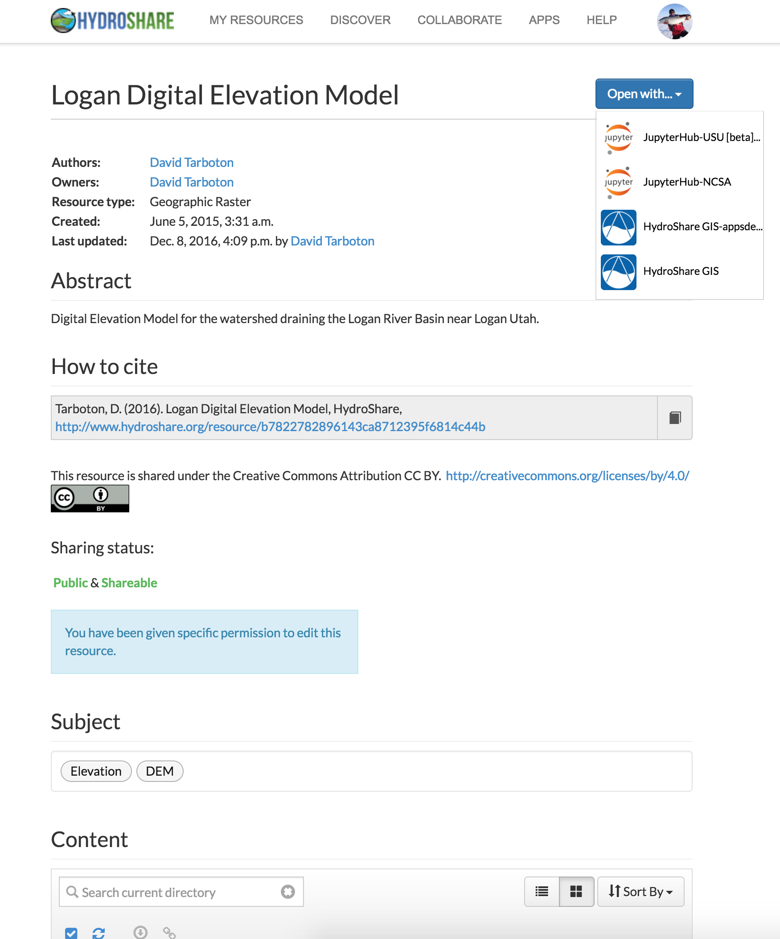
Resource Types in HydroShare
Generic
Multidimensional (NetCDF)
Collections
Geographic
Raster
Feature (ESRI Shapefiles)
Time Series
Time Series
Referenced Time Series
Modeling
Model Program
Model Instance
SWAT Model Instance
MODFLOW Model Instance
Script
Specific Resource types have:
A specific metadata description
An expected file format and structure
A geographic
Raster Resource
Is automatically
recognized by apps
Notes:
Most iutah datasets are generic, but some are specific, and apps can use specific resource types.
Refernce Jon’s modeling presentation

Slide 11
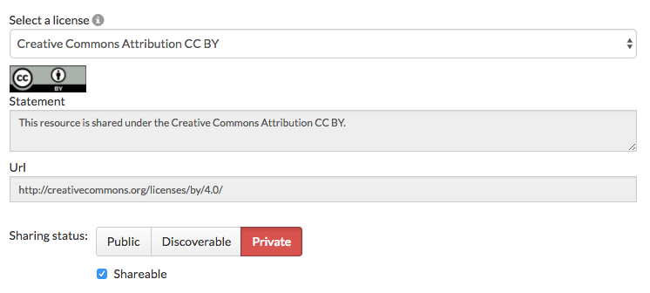
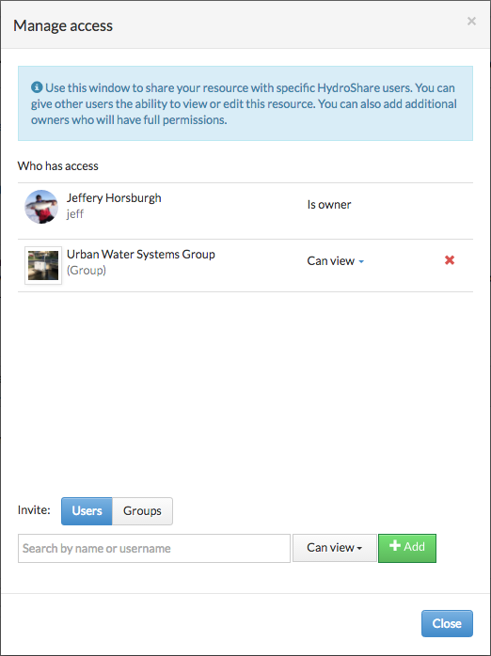
Resource Sharing in HydroShare
Users control who has access
5 Options:
Private – Only individual users or groups you have given access can view metadata or access content
Discoverable – Anyone can view the metadata, but only users with permission can access content
Public – Anyone can view the metadata and access content
Published – Same as public, but the resource is made immutable and a DOI is assigned
Shareable – Other users can grant access at their same level of access
Share with individuals or groups
This fit iUTAH’s investigator workflows much better…

Slide 12
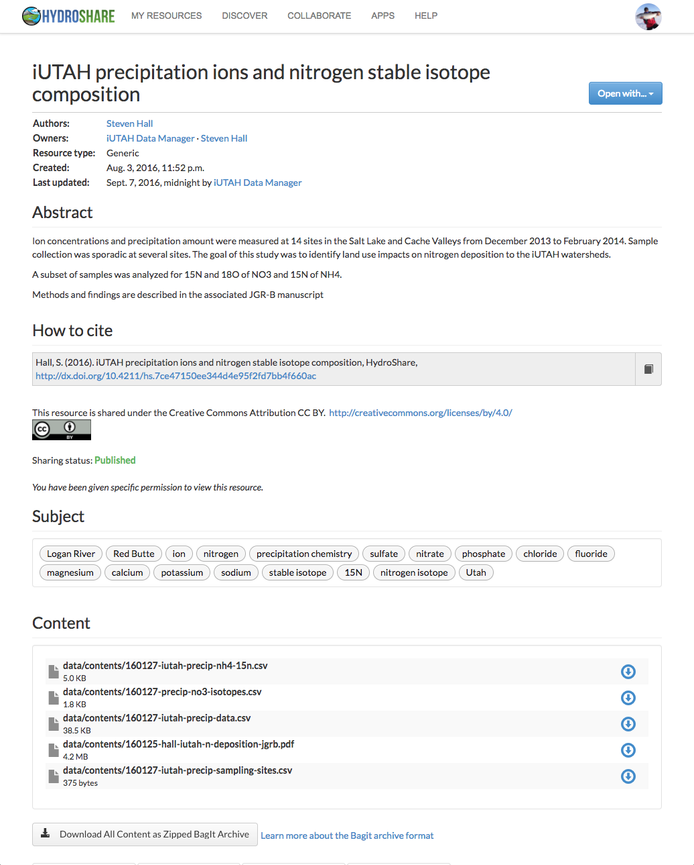
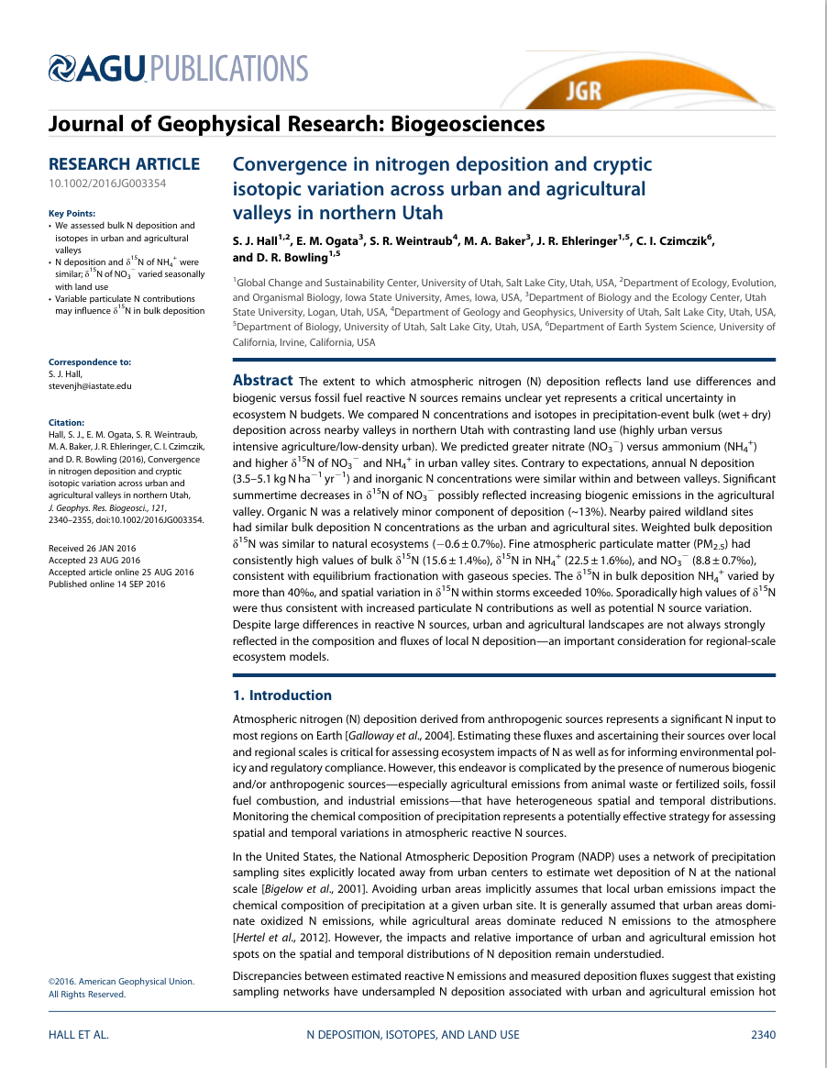

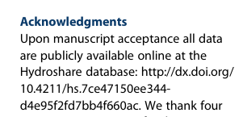
The Steven Hall Story
Steven verified his data and metadata were correct but kept the data private
Steven submitted his paper for publication and responded to reviews
Steven published his data in HydroShare and received a DOI
Steven deposited his dataset in the online HydroShare repository
Steven collected his data in the field and transformed into a sharable format
Steven published his paper and cited published data in HydroShare

Slide 13
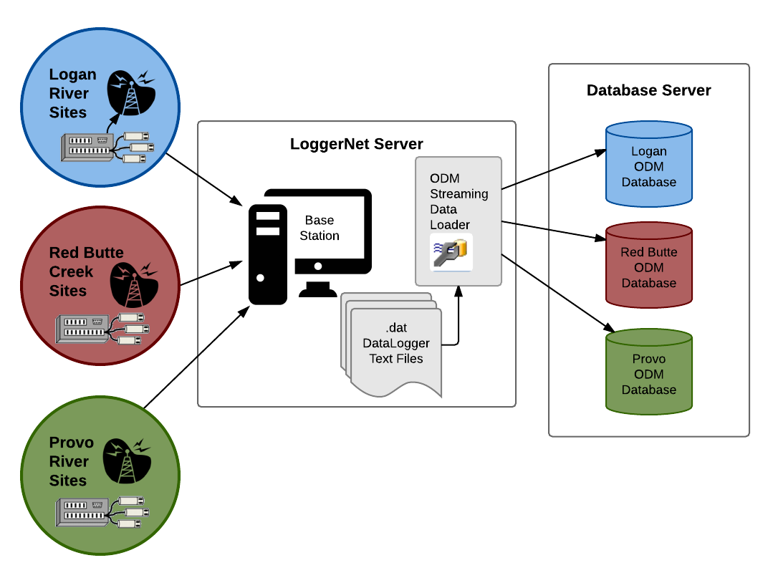
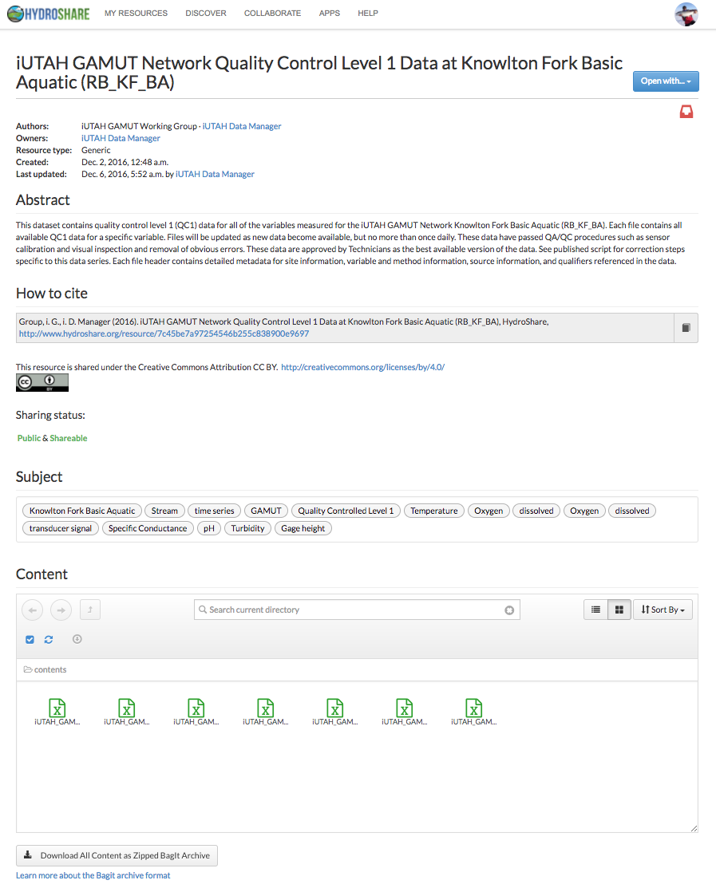

Automated Sensor Data Publication Workflow
Streaming Data from the iUTAH Sensor Network
iUTAH
Python
Utilities
REST API

Slide 14
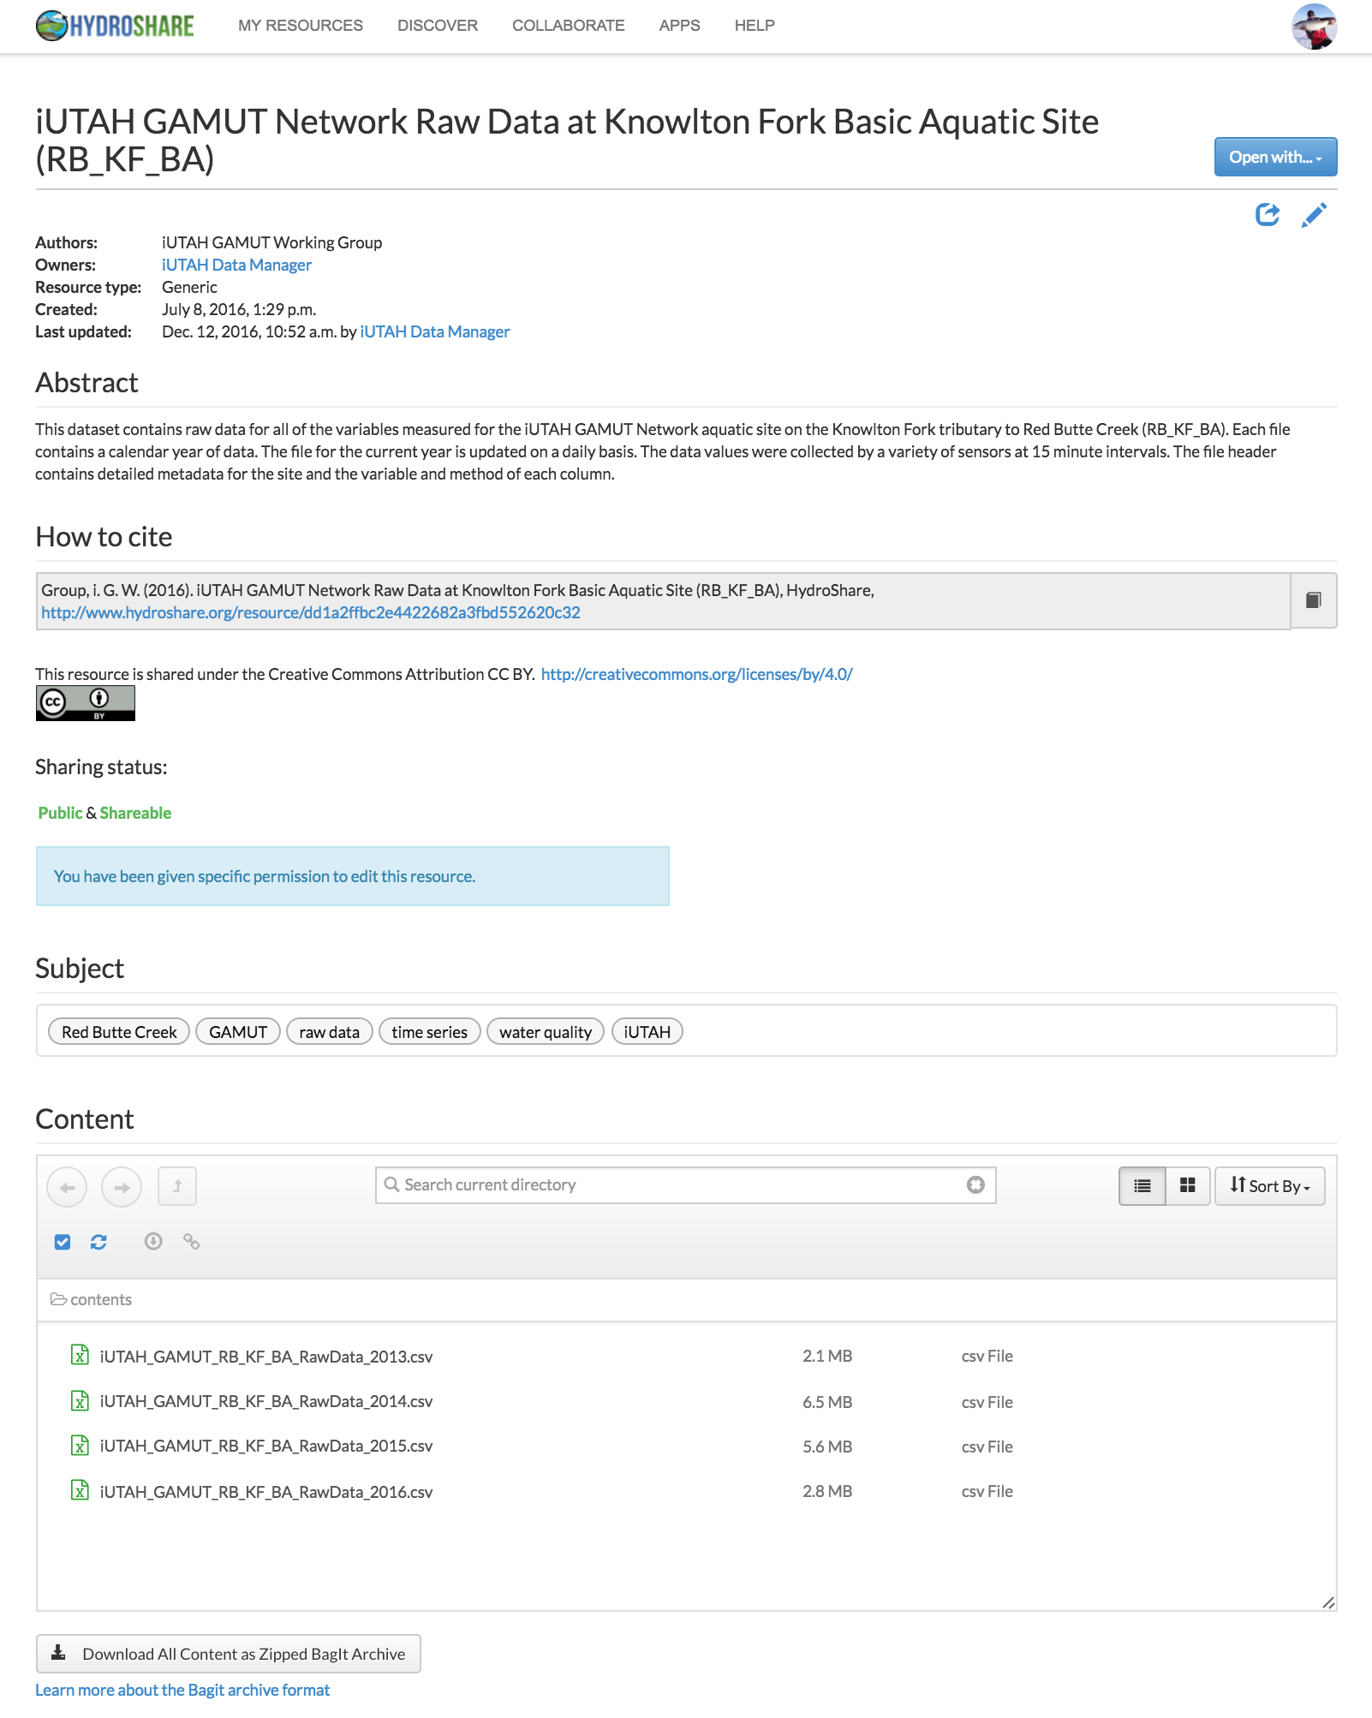
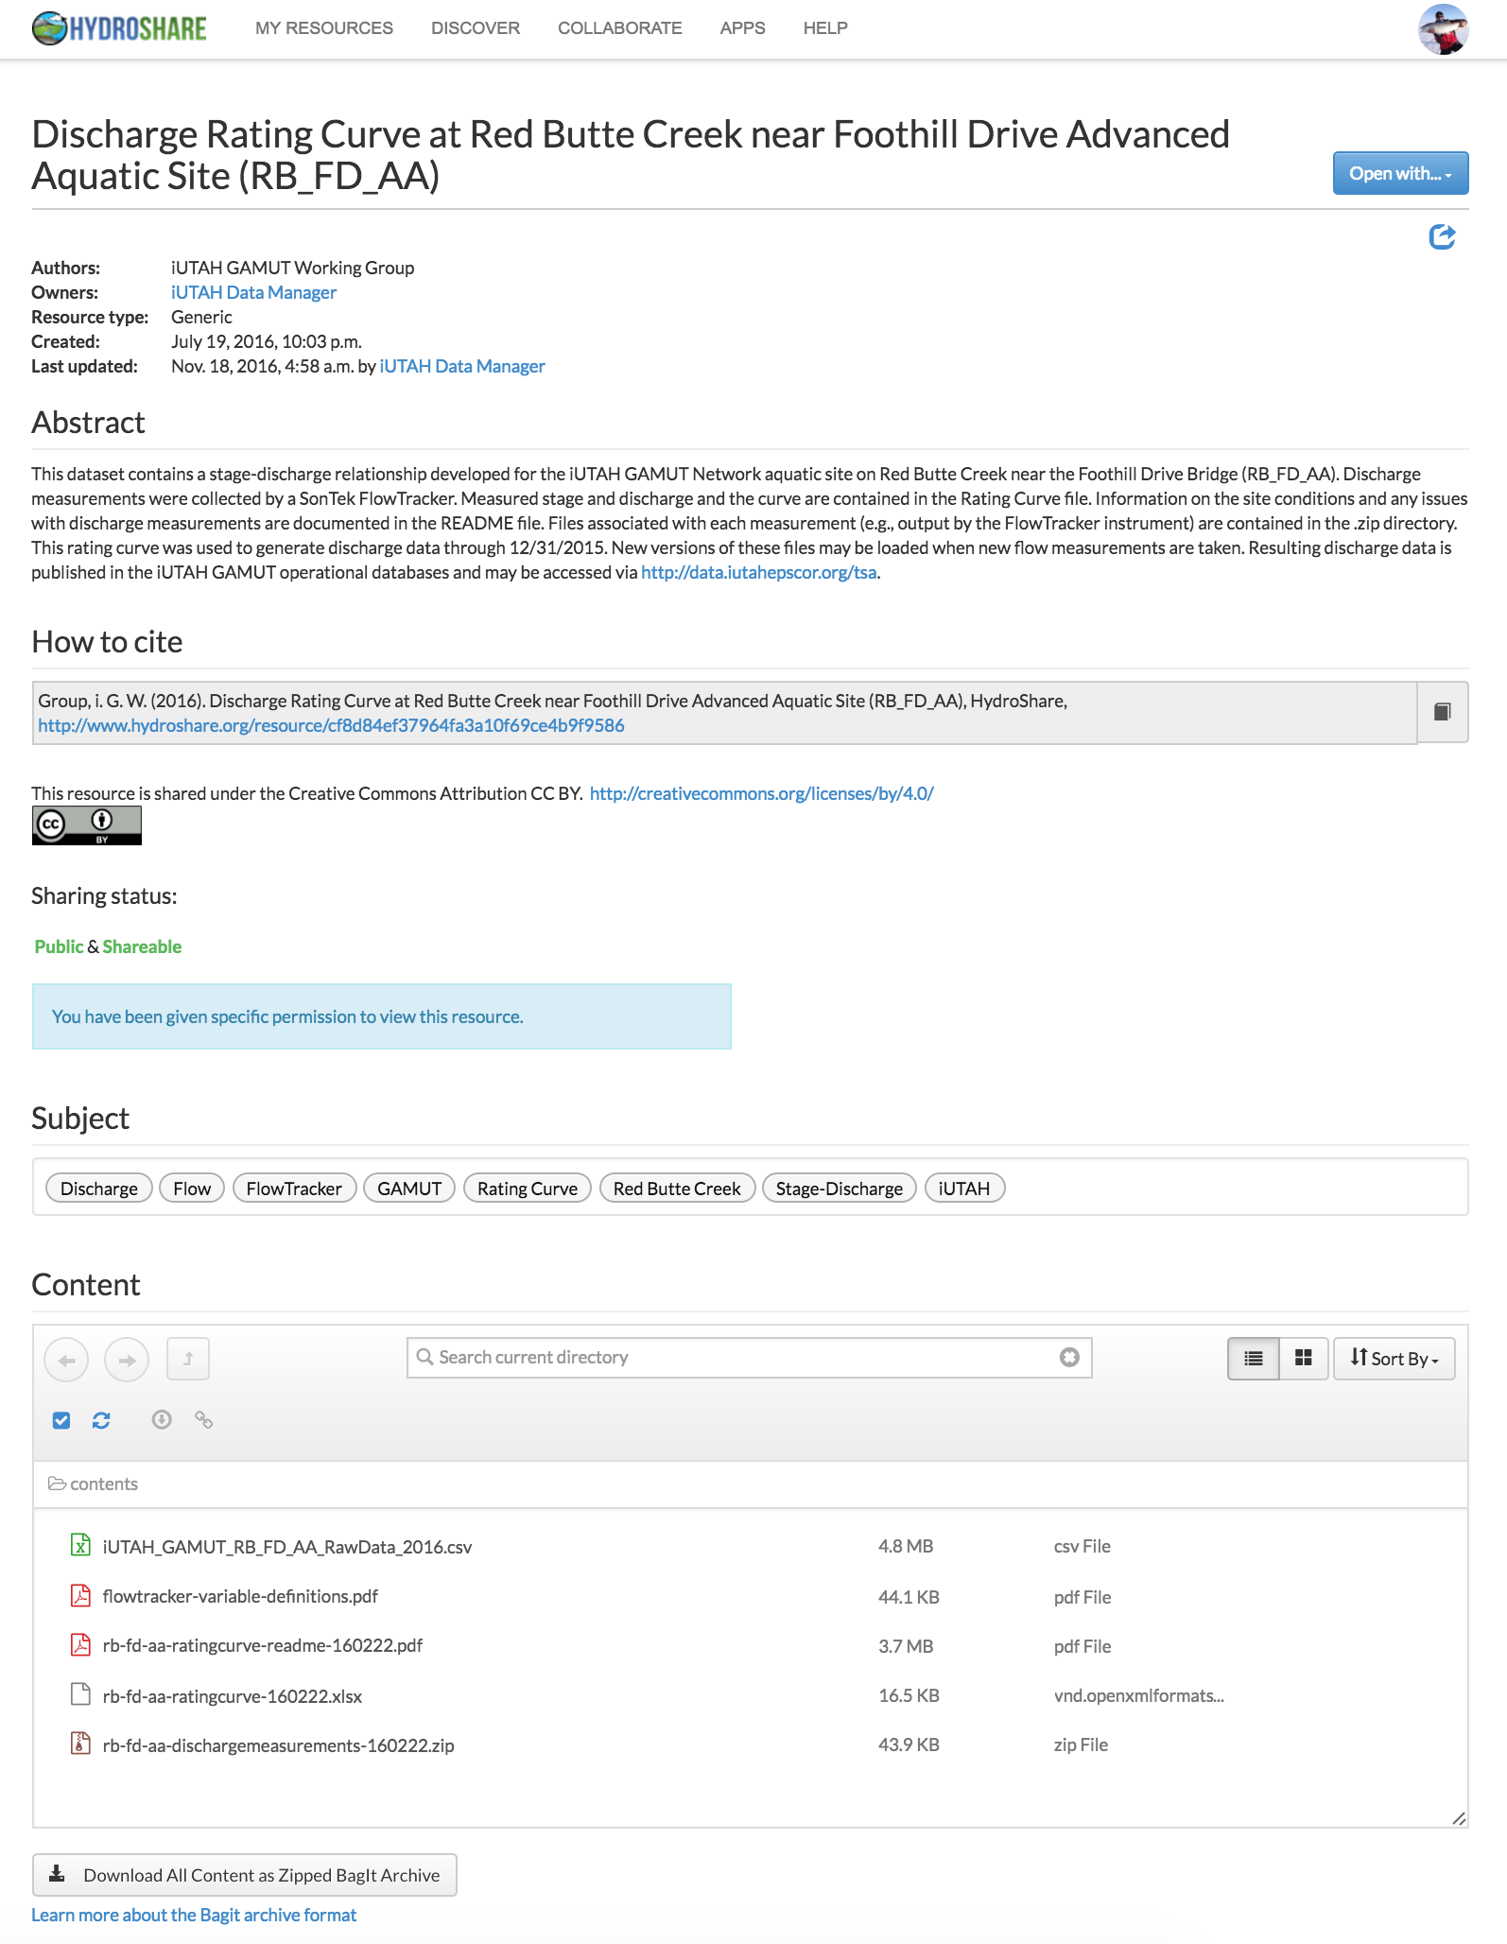
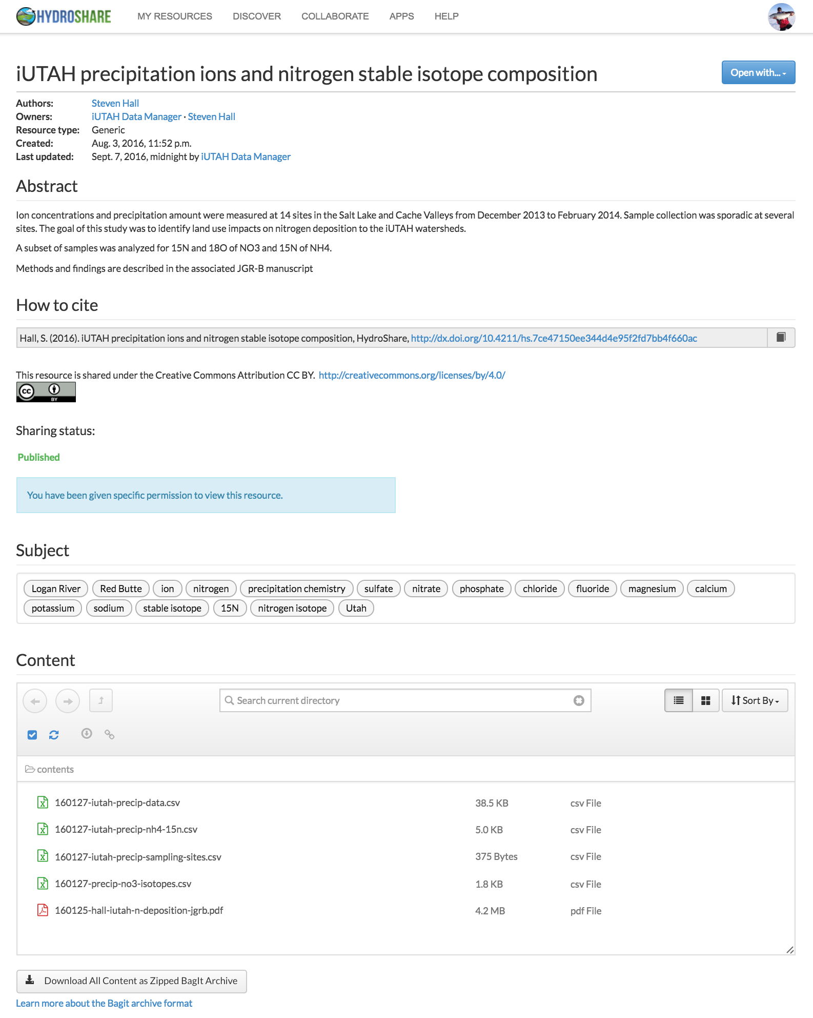
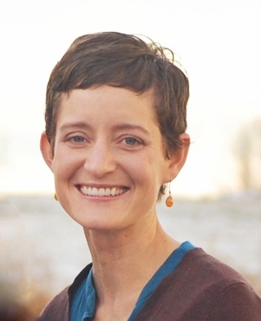
iUTAH Resources in HydroShare
GAMUT Raw and QC1 Datasets
(Automated)
GAMUT Discharge Rating Curves
(Deposited by Data Manager)
Individual Investigator Datasets
(Deposited by Investigator)

Slide 15
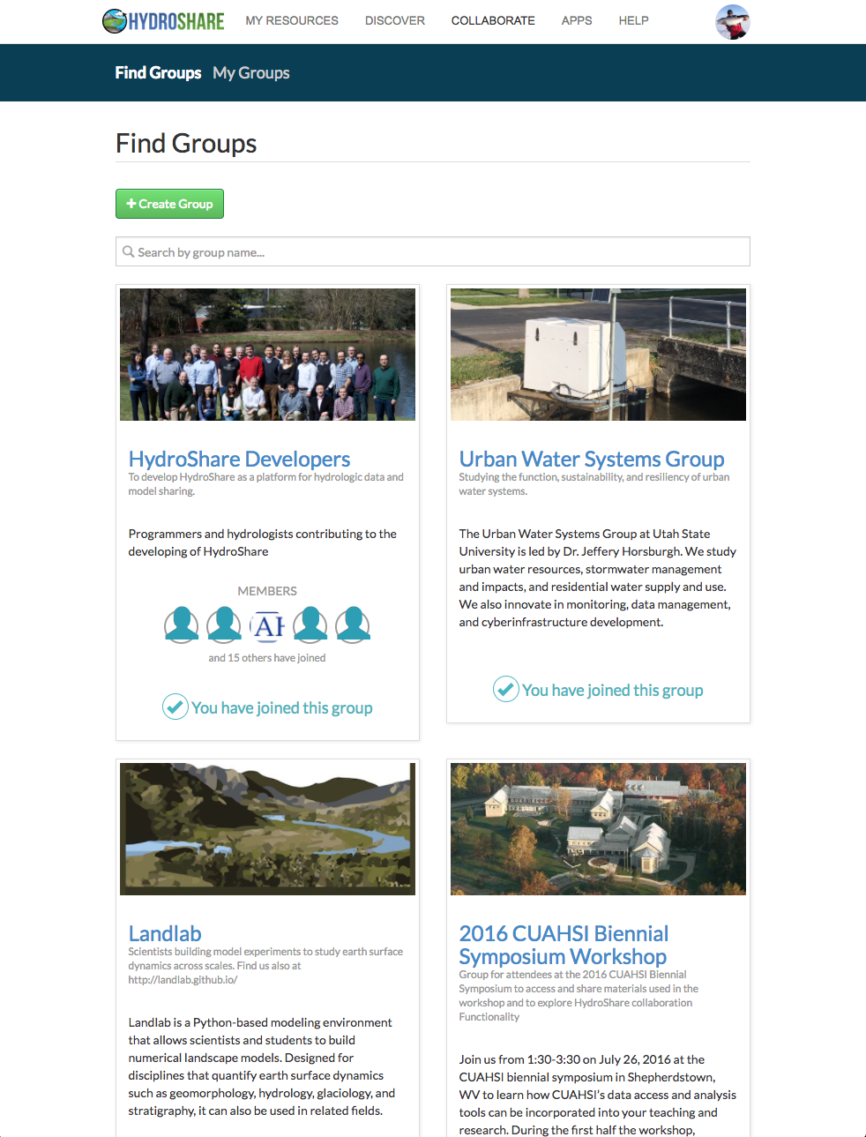
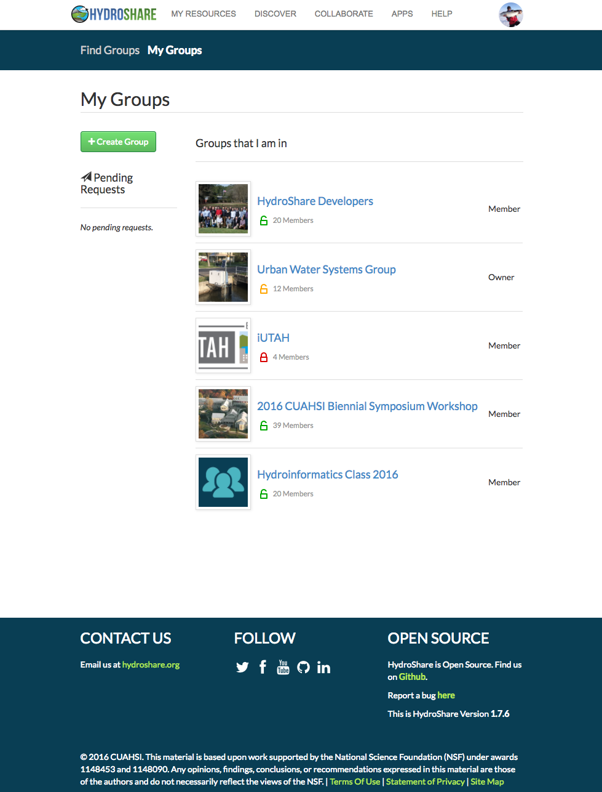
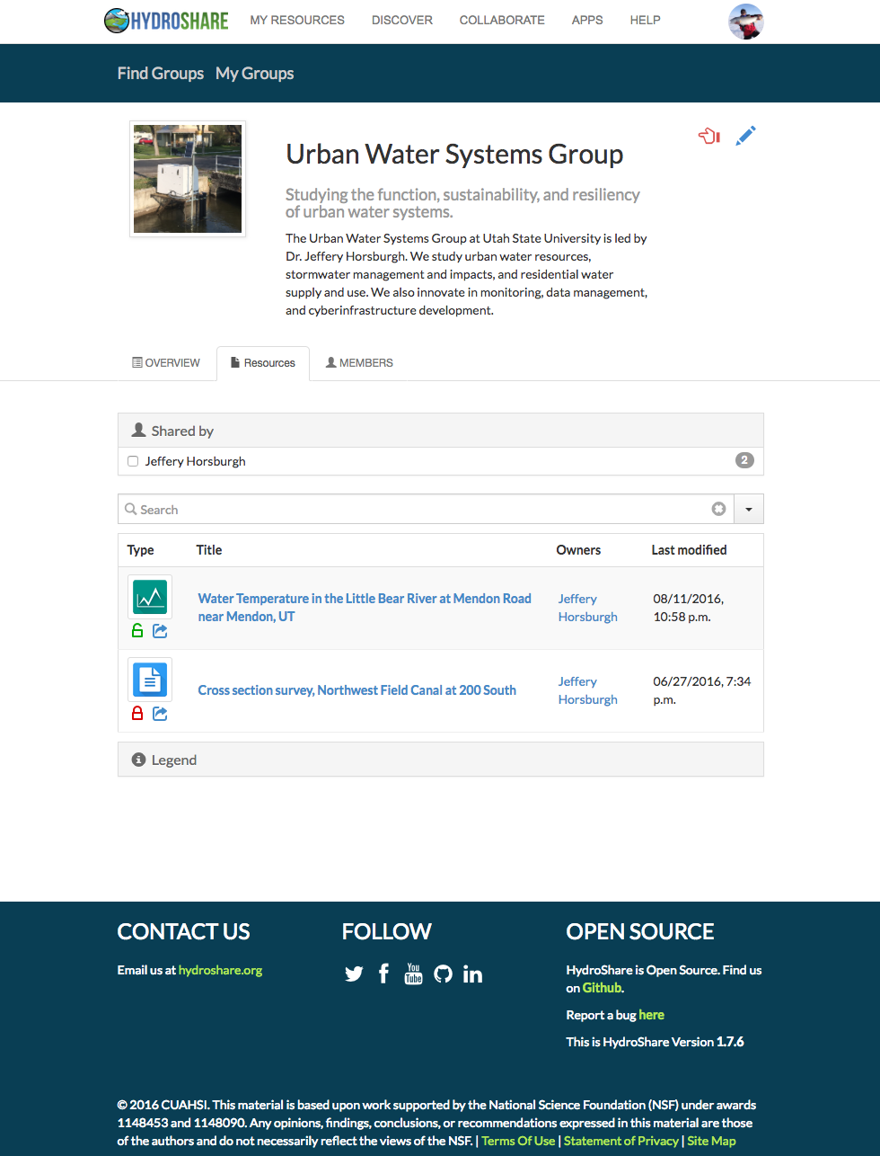
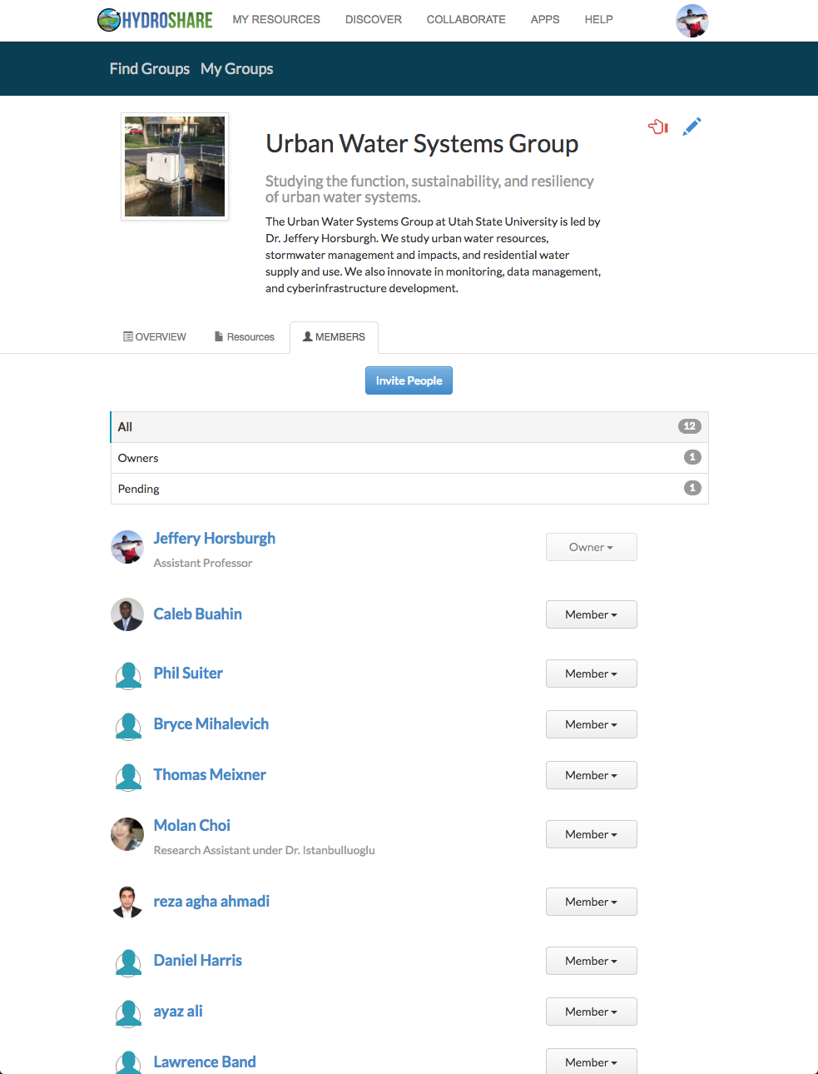
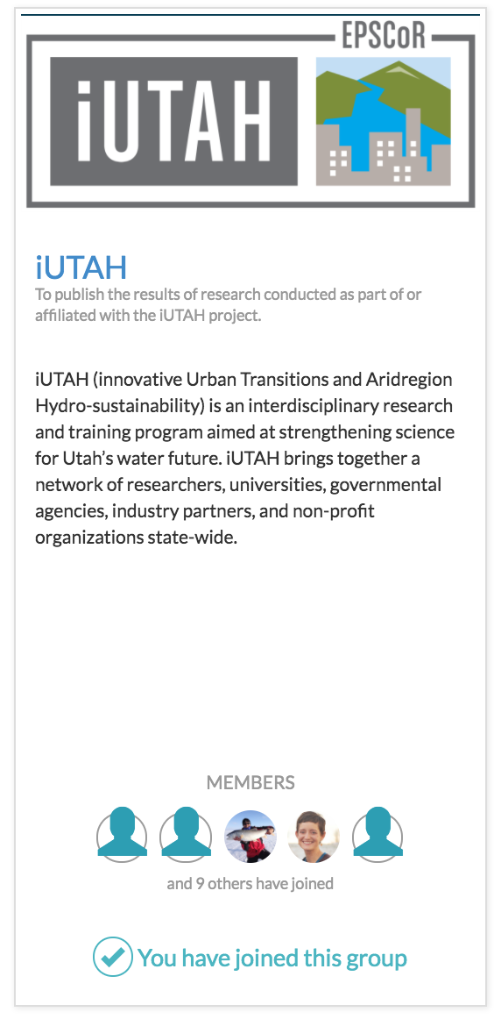
Collaborative User Groups
Create a group
Share resources with a group
Manage group membership
Find groups you are interested in
Request group membership
Groups provide a convenient way to share resources and collaborate
Notes:
Swap out with iUTAH Group
All iUTAH datasets are shared with the iUTAH Group
All iUTAH investigators are members of the group
Smaller groups can form

Slide 16
Collaborative Capabilities of HydroShare
Dataset/model creation as a “Resource”
Resource sharing (public and private)
Collaborative groups and sharing within groups
Resource versioning
Formal Publication of resources and assignment of DOIs
Rating and commenting on resources

Slide 17
“All of the primary datasets collected as part of this project will be made freely and publicly available…”
Technical challenges:
A flexible data model that can handle diverse data types
Capability for sharing and working with heterogeneous data
Software/apps/systems that add value to resources
Formal publication
Cultural challenges:
HydroShare enhances “personal cyberinfrastructure”
Provides a place and a workflow to meet data sharing obligations
Public and private sharing with room for curation
An enhanced, cloud connected, and social scientific workflow
A work in progress…

Slide 18
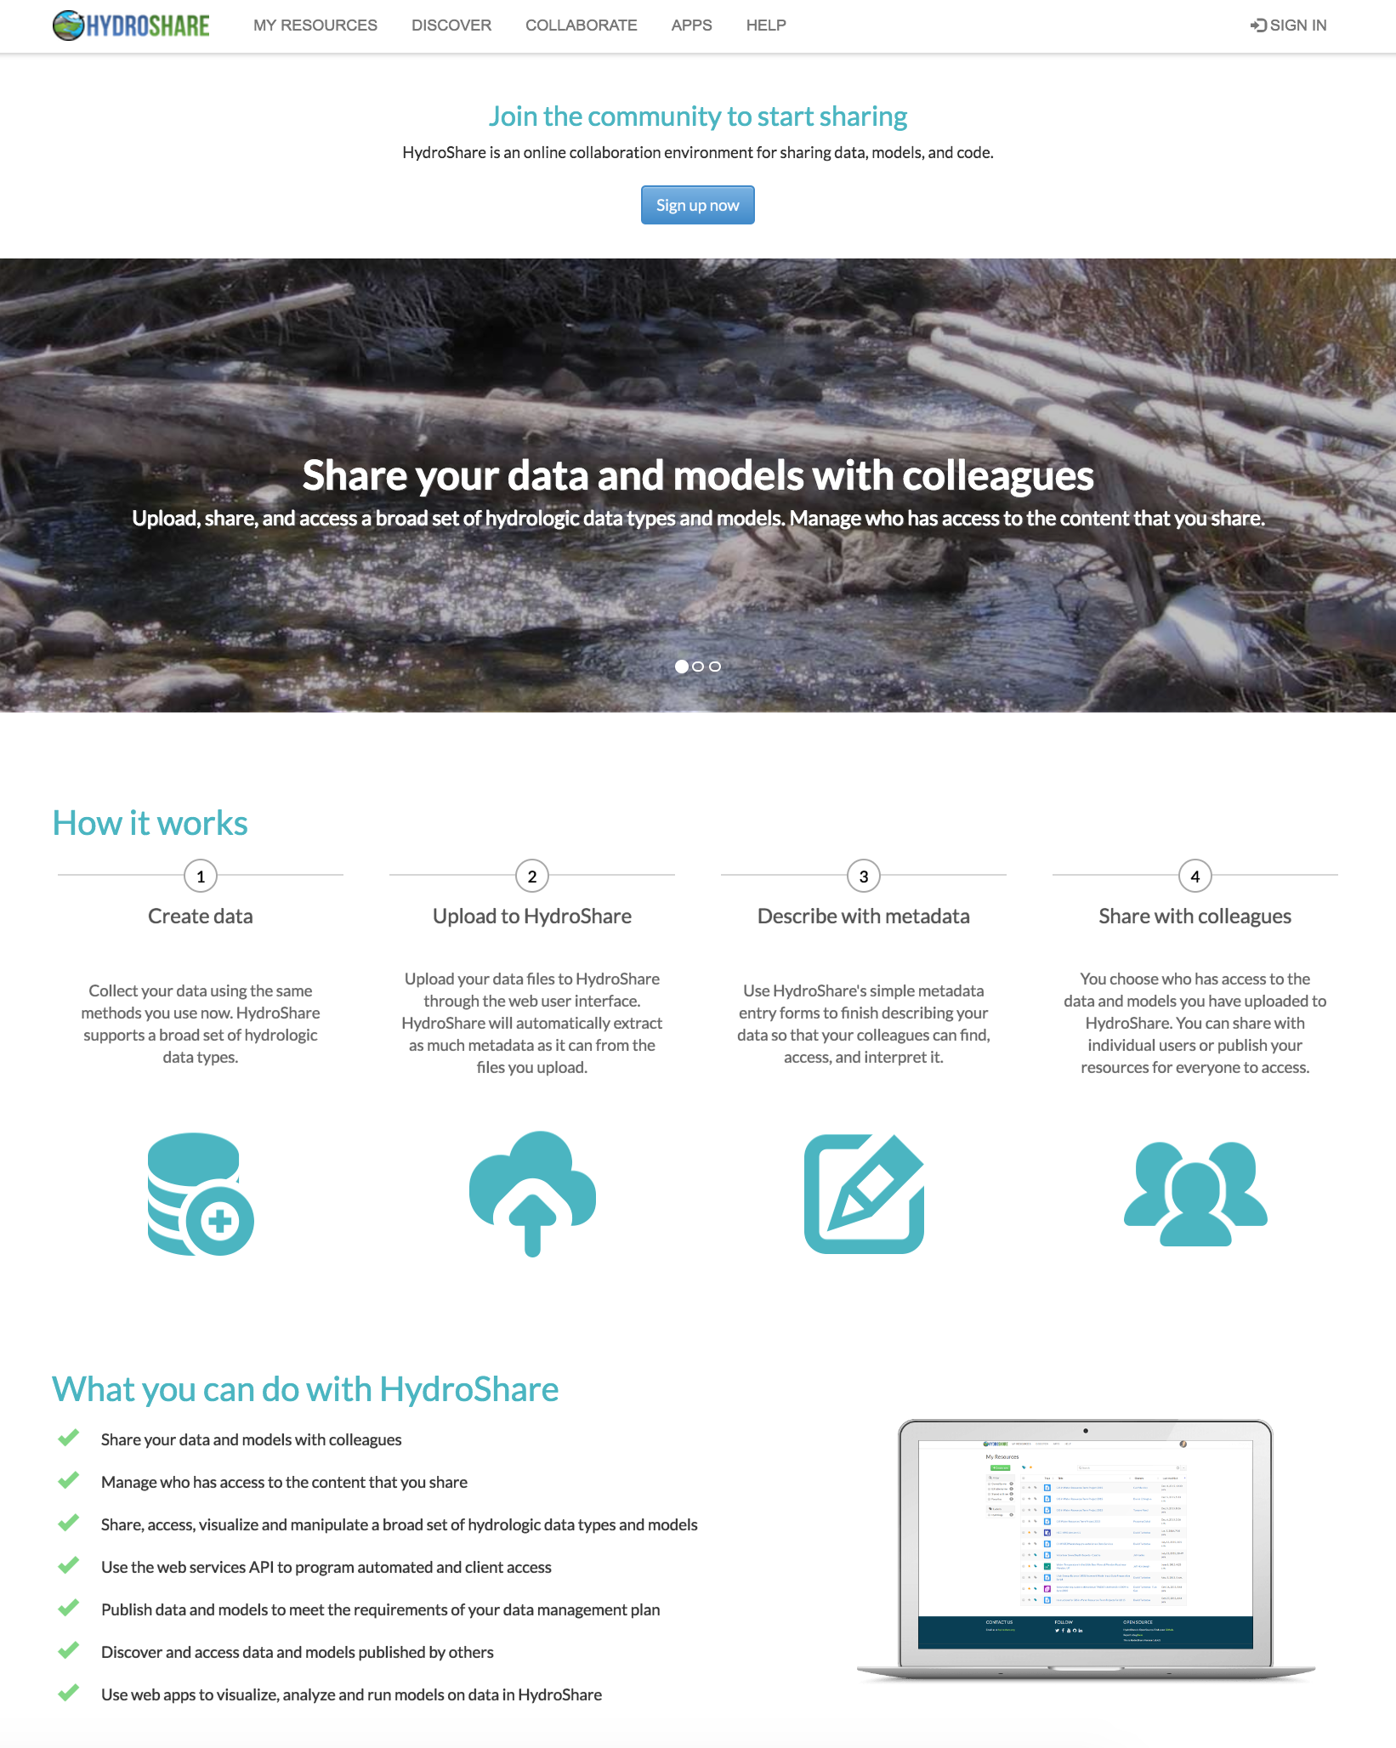
Questions?
http://www.hydroshare.org
http://data.iutahepscor.org
Jeffery S. Horsburgh
jeff.horsburgh@usu.edu
http://jeffh.usu.edu
iUTAH Support: 1208732
HydroShare Support: 1148453, 1148090

